Slide 1
Exploring Data Pipelines for Spark Streaming Applications
Carol McDonald, Industry Solutions Architect
2016

Slide 2


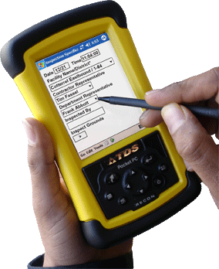

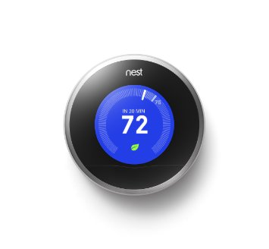
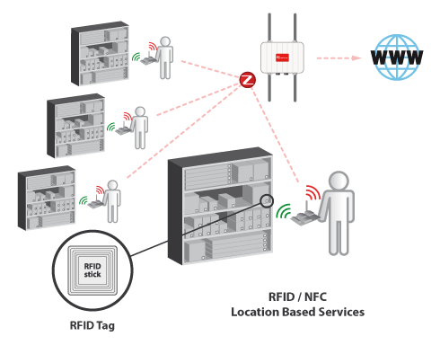



What is Streaming Data? Got Some Examples?
Data Collection Devices
Smart Machinery
Phones and Tablets
Home Automation
RFID Systems
Digital Signage
Security Systems
Medical Devices
Notes:
Many of the systems we want to monitor happen as a stream of events, some examples include event data from mobile applications, log transactions, and all kinds of sensors and devices.

Slide 3




Why Stream Processing?
Batch processing may be too late for some events
Analyze
It was hot at 6:05 yesterday!
90°
6:01 P.M.: 72°
6:02 P.M.: 75°
6:03 P.M.: 77°
6:04 P.M.: 85°
6:05 P.M.: 90°
6:06 P.M.: 85°
6:07 P.M.: 77°
6:08 P.M.: 75°
90°
6:01 P.M.: 72°
6:02 P.M.: 75°
6:03 P.M.: 77°
6:04 P.M.: 85°
6:05 P.M.: 90°
6:06 P.M.: 85°
6:07 P.M.: 77°
6:08 P.M.: 75°
Notes:
Batch processing can give great insights into things that happened in the past, but it lacks the ability to answer the question of "what is happening right now?”

Slide 4

Why Stream Processing?
It’s becoming important to process events as they arrive
Stream
Turn on the air conditioning!
6:05 P.M.: 90°
Temperature
Topic
Notes:
It is becoming important to process events as they arrive for real-time insights, but high performance at scale is necessary to do this.

Slide 5

Key to Real Time: Event-based Data Flows
etc…
web events
machine sensors
Mobile events
Biometrics
Notes:
Event based data flows …… require flowing data to be quickly analyzed and understood in context.

Slide 6

What if BP had detected problems before the oil hit the water ?
1M samples/sec
High performance at scale is necessary!
Notes:
Let’s go over an example which generates lot of data and needs real time alerts , Remember what happened with BP in the Gulf coast?

Slide 7


Use Case: Time Series Data
Stream
Spark Streaming
read
Topic
Sensor
time-stamped data
Data for
real-time monitoring
Spark processing
Notes:
The example use case we will look at here is an application that monitors oil wells. Sensors in oil rigs generate streaming data, which is processed by Spark and stored in HBase, for use by various analytical and reporting tools. We want to store every single event in HBase as it streams in. We also want to filter for, and store alarms. Daily Spark processing will store aggregated summary statistics.

Slide 8
Schema
All events stored, CF data could be set to expire data
Filtered alerts put in CF alerts
Daily summaries put in CF stats
Row key | CF data |  |  | CF alerts |  | CF stats
 | hz | … | psi | psi | … | hz_avg | … | psi_min
COHUTTA_3/10/14_1:01 | 10.37 |  | 84 | 0
COHUTTA_3/10/14 |  |  |  |  |  | 10 |  | 0
Row Key contains oil pump name, date, and a time stamp
Notes:
The HBase table schema for the streaming data is as follows:
The row key is a composite of the oil pump name, date, and a time stamp

Slide 9
Schema
All events stored, CF data could be set to expire data
Filtered alerts put in CF alerts
Daily summaries put in CF stats
Row key | CF data |  |  | CF alerts |  | CF stats
 | hz | … | psi | psi | … | hz_avg | … | psi_min
COHUTTA_3/10/14_1:01 | 10.37 |  | 84 | 0
COHUTTA_3/10/14 |  |  |  |  |  | 10 |  | 0
Notes:
The Column Family “data” contains columns corresponding to the input data fields.
The Column Family “alerts” contains columns corresponding to any filters for alarms.
Note that the data and alert column families could be set to expire values after a certain amount of time.

Slide 10
Schema
All events stored, CF data could be set to expire data
Filtered alerts put in CF alerts
Daily summaries put in CF stats
Row key | CF data |  |  | CF alerts |  | CF stats
 | hz | … | psi | psi | … | hz_avg | … | psi_min
COHUTTA_3/10/14_1:01 | 10.37 |  | 84 | 0
COHUTTA_3/10/14 |  |  |  |  |  | 10 |  | 0
Notes:
The Schema for the daily statistics summary rollups is as: the composite row key of the pump name and date, and then the Column Family “stats”

Slide 11
What Do We Need to Do ?
Data Sources
Collect Data
Process Data
Store Data
Serve Data
?
?
?
?
Notes:
What do we need to do ? We need to collect the data , process the data, store the data , and finally serve the data for Analysis , Machine Learning, Dashboards…

Slide 12
How do we do this with High Performance at Scale?
Parallel operations and minimize disk read/write time

Slide 13

Collect the Data
Source
Data Ingest
Data Ingest:
File Based: NFS with MapR-FS, HDFS
Network Based: MapR Streams, Kafka, Kinesis, Twitter, Sockets...
Stream
Topic
MapR-FS
Notes:
Spark Streaming supports data delivered through Network messaging systems or deposited in a file system. In our example, we will use MapR Streams, a new distributed messaging system for streaming event data at scale. MapR Streams enables producers and consumers to exchange events in real time via the Apache Kafka 0.9 API.

Slide 14
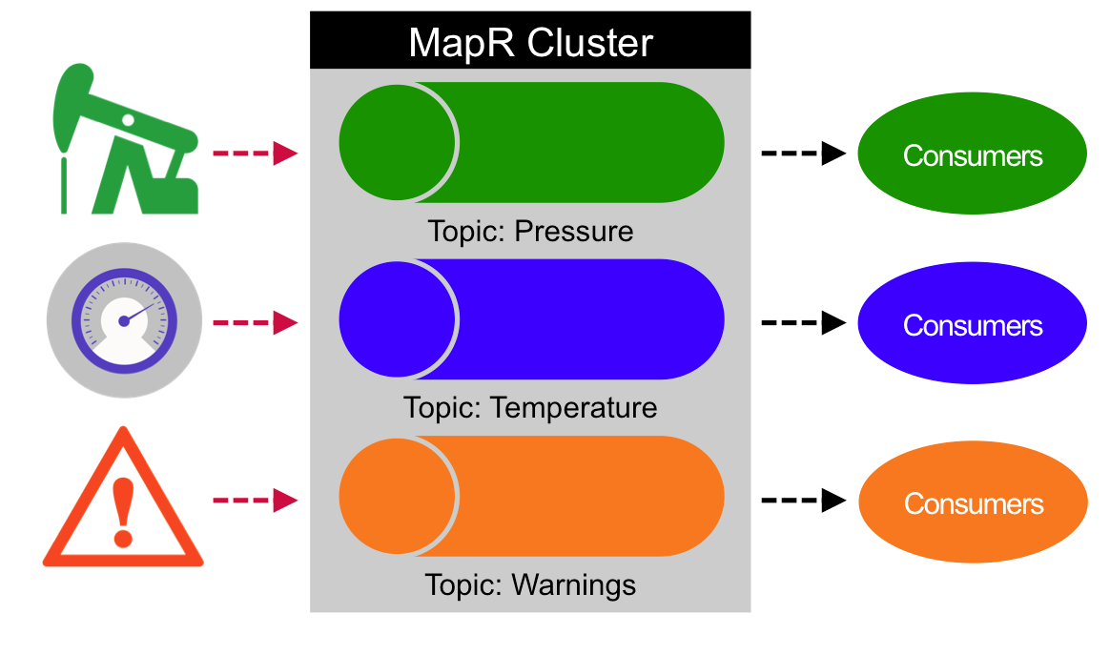
MapR Streams Publish Subscribe Messaging
Topics Organize Events into Categories
and decouple Producers from Consumers
Notes:
MapR Streams Topics are logical collections of messages that are managed by MapR Streams.
Topics organize events into categories. Topics decouple producers, which are the sources of data, from consumers, which are the applications that process, analyze, and share data.

Slide 15
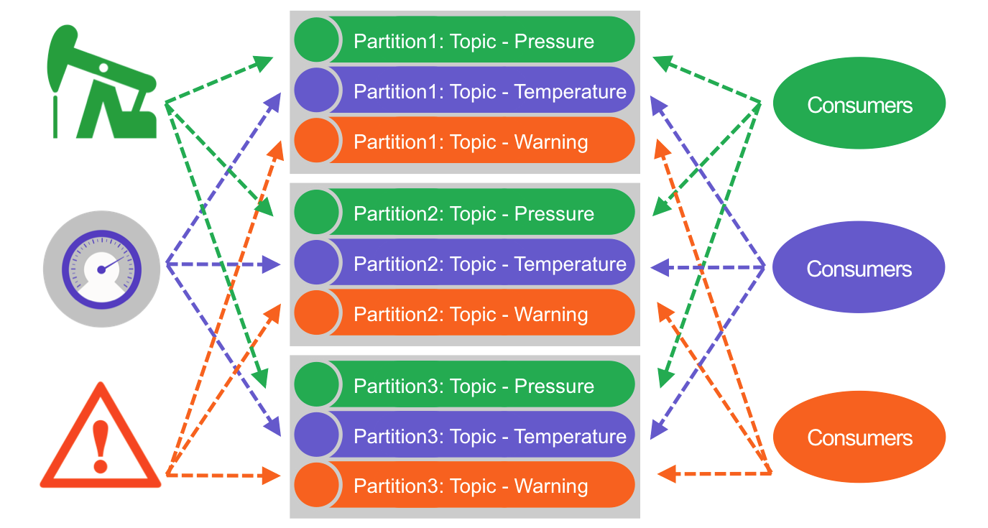
Scalable Messaging with MapR Streams
Topics are partitioned for throughput and scalability
Notes:
Topics are partitioned for throughput and scalability. Partitions make topics scalable by spreading the load for a topic across multiple servers. Producers are load balanced between partitions and consumers can be grouped to read in parallel from multiple partitions within a topic for faster performance. Partitioned parallel messaging is a key to high performance at scale.

Slide 16
How do we do this with High Performance at Scale?
Parallel , Partitioned = fast , scalable
Messaging with MapR Streams
Notes:
MapR Streams performance scales linearly as servers are added within a cluster, with each server handling more than 1 million messages per second.

Slide 17
Process the Data with Spark Streaming
Collect Data
Process Data
Extension of the core Spark AP
Enables scalable, high-throughput, fault-tolerant stream processing of live data
Stream
Topic
MapR-FS
Notes:
Spark Streaming brings Spark's APIs to stream processing, letting you use the same APIs for streaming and batch processing.
Data Streams can be processed with Spark’s core APIS, Dataframes SQL, GraphX or machine learning APIs, and can be persisted to a HDFS, MapR-FS, MapR-DB, HBase, or any data source offering a Hadoop OutputFormat or Spark connector.

Slide 18
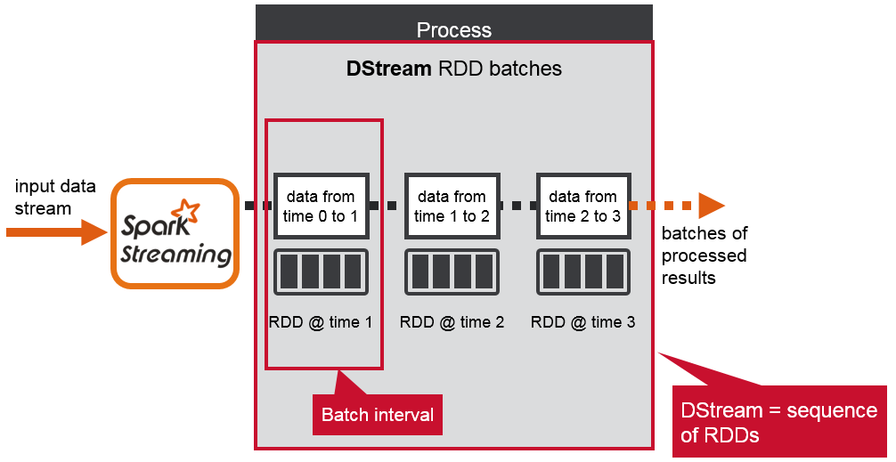
Processing Spark DStreams
Data stream divided into batches of X milliseconds = DStreams
Notes:
Spark Streaming divides the data stream into batch intervals called DStreams.
Underneath the covers a dstream is composed of a sequence of RDDs, one for each batch interval
Each RDD contains the records received during the batch interval.

Slide 19
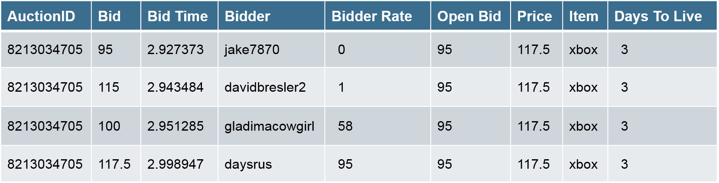

Spark Resilient Distributed Datasets
RDD
Spark revolves around RDDs
Read only collection of elements
Partitioned across a cluster
Operated on in parallel
Cached in memory
Partition 1 8213034705, 95, 2.927373, jake7870, 0…… | Partition 2 8213034705, 115, 2.943484, Davidbresler2, 1…. | Partition 3 8213034705, 100, 2.951285, gladimacowgirl, 58… | Partition 4 8213034705, 117, 2.998947, daysrus, 95….
partitioned
W
W
W
Executor
Executor
Executor
P1
P3
P4
P2
Notes:
Resilient distributed datasets, or RDD, are the primary abstraction in Spark. An RDD is simply a distributed collection of elements, like a list , except that it’s spread out across multiple nodes in the cluster.

Slide 20
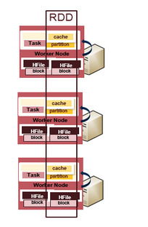
Spark Resilient Distributed Datasets
Spark revolves around RDDs
Read only collection of elements
Partitioned across a cluster
Operated on in parallel
Cached in memory
Notes:
The data contained in RDDs is partitioned and operations are performed in parallel on the data cached in memory. Spark caches RDDs in memory, whereas MapReduce involves more reading and writing from disk.

Slide 21
How do we do this with High Performance at Scale?
Parallel , Partitioned = fast , scalable
Processing with Spark
Notes:
Here again the key to high performance at scale is partitioning and minimizing disk I/O.

Slide 22
Processing Spark DStreams
transformations → create new RDDs
Two types of operations on DStreams:
Transformations:
Create new DStreams
map, filter, reduceByKey, SQL. . .
Output Operations
data from time 0 to 1
data from time 1 to 2
data from time 2 to 3
DStream
RDDs
RDD @ time 1
RDD @ time 2
RDD @ time 3
transform
transform
transform
DStream
RDDs
RDD @ time 1
RDD @ time 2
RDD @ time 3
Notes:
There are two types of operations on DStreams: transformations and output operations.
Your Spark application processes the DStream RDDs using Spark transformations like map, reduce, and join, which create new RDDs. Any operation applied on a DStream translates to operations on the underlying RDDs, which in turn, applies the transformation to the elements of the RDD.

Slide 23



Processing Spark DStreams
Output operations → trigger computation
Two types of operations on DStreams
Transformations
Output Operations: trigger Computation
Save to File, HBase..
saveAsHadoopFiles
saveAsHadoopDataset
saveAsTextFiles
data from time 0 to 1
data from time 1 to 2
data from time 2 to 3
DStream
RDDs
RDD @ time 1
RDD @ time 2
RDD @ time 3
map
map
map
save
save
save
MapR-FS
MapR-DB
Notes:
Examples of output operations are saveAsHadoopFiles, which saves to a Hadoop-compatible file system, and saveAsHadoopDataset, which saves to any Hadoop-supported storage system.

Slide 24

What Do We Need to Do ?
Data Sources
Collect Data
Process Data
Store Data
Serve Data
MapR-FS
Stream
Topic
MapR-FS
Notes:
For Storing lots of Streaming Data we need a data store that supports fast writes and scales

Slide 25


MapR-DB (HBase API) is Designed to Scale
Key Range
xxxx
xxxx
Key | colB | colC
val | val | val
xxx | val | val
Key Range
xxxx
xxxx
Key | colB | colC
val | val | val
xxx | val | val
Key Range
xxxx
xxxx
Key | colB | colC
val | val | val
xxx | val | val
Fast Reads and Writes by Key
Data is automatically partitioned by Key Range
Notes:
With MapR-DB (HBase API), a table is automatically partitioned across a cluster by key range, and each server is the source for a subset of a table. Grouping the data by key range provides for really fast read and writes by row key.
Also with MapR-DB each region of a table has a write and read cache. Recently read or written data and cached column families are available in memory, providing for really fast read and writes.

Slide 26

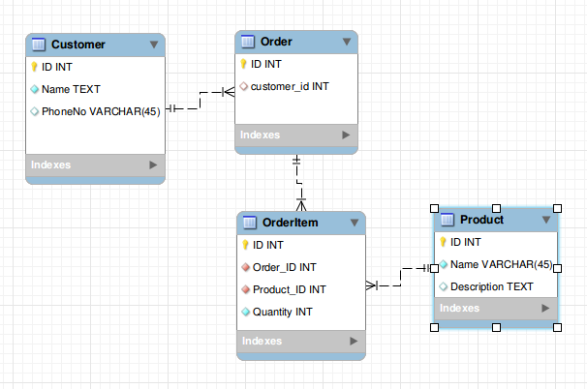

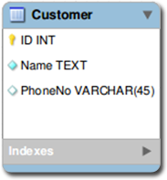

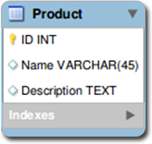
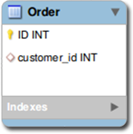
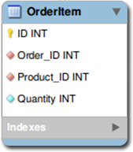
Store Lots of Data with NoSQL MapR-DB
RDBMS
Storage Model
MapR-DB
Key | colB | colC
val | val | val
xxx | val | val
Key | colB | colC
val | val | val
xxx | val | val
bottleneck
Key | colB | colC
val | val | val
xxx | val | val
Normalized schema → Joins for queries can cause bottleneck
De-Normalized schema → Data that is read together is stored together
Notes:
With a relational database and a normalized schema, query joins cause bottlenecks with lots of data. MapR-DB and a de-normalized schema scales because data that is read together is stored together.

Slide 27
Key to Real Time: Event-based Data Flows
Key to Scale = Parallel Partitioned:
Messaging
Processing
Storage
Notes:
So how do we collect, process, and store real-time events with high performance at scale? The key is partitioning, caching, and minimizing time spent on Disk reads and writes for :
Messaging with MapR Streams
Processing with Spark Streaming
Storage with MapR-DB

Slide 28




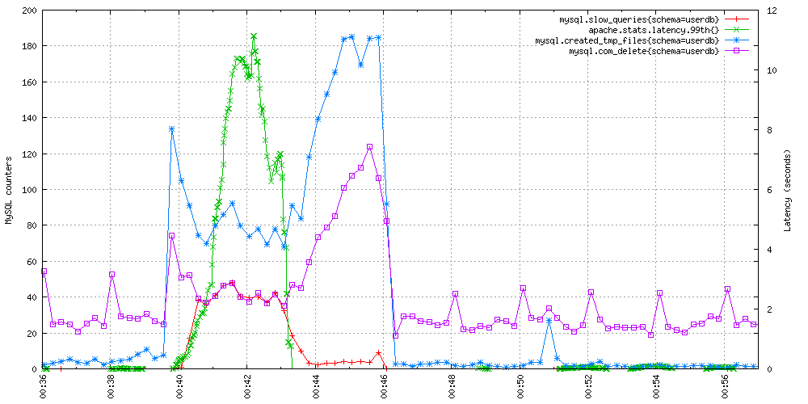
What Do We Need to Do ?
Data Sources
Collect Data
Process Data
Store Data
Serve Data
MapR-FS
Stream
Topic
MapR-FS
Notes:
End applications like dashboards, business intelligence tools, and other applications use the processed event data. The processing output can also be stored back in MapR-DB, in another Column Family or Table, for further processing later.

Slide 29
Use Case Example Code
Stream
Spark Streaming
read
Topic
Sensor
time-stamped data
Data for
real-time monitoring
Spark processing
Notes:
Now we will step through the code for a MapR Streams producer sending messages, and for Spark Streaming processing the events and storing data in MapR-DB

Slide 30
Use Case Example Code
Stream
Spark Streaming
read
Topic
Sensor
time-stamped data
Data for
real-time monitoring
Spark processing
Notes:
First we will look at the MapR Streams publisher code

Slide 31
KafkaProducer
String topic=“/streams/pump:warning”;
public static KafkaProducer producer;
Properties properties = new Properties();
properties.put("value.serializer",
"org.apache.kafka.common.serialization.StringSerializer");
// Instantiate KafkaProducer with properties
producer = new KafkaProducer<String, String>(properties);
String txt = “msg text”;
ProducerRecord<String, String> rec = new
ProducerRecord<String, String>(topic, txt);
producer.send(rec);
Notes:
Set producer properties
Create a KafkaProducer
Build the ProducerRecord message
Send the message

Slide 32
Use Case Example Code
Stream
Spark Streaming
read
Topic
Sensor
time-stamped data
Data for
real-time monitoring
Spark processing
Notes:
Next we will look at the Spark Streaming code

Slide 33
Create a DStream
val ssc = new StreamingContext(sparkConf, Seconds(5))
val dStream = KafkaUtils.createDirectStream[String,
String](ssc, kafkaParams, topicsSet)
batch time 0 to 1
batch time 1 to 2
batch time 2 to 3
dStream
DStream: a sequence of RDDs representing a stream of data
Stored in memory as an RDD
Notes:
In this example we use the KafkaUtils createDirectStream method to create an input stream from a MapR Streams topic.
This creates a DStream that represents the stream of incoming data, where each record is a line of text.
Internally a DStream is a sequence of RDDs, one RDD per batch interval.

Slide 34
Process DStream
val sensorDStream = dStream.map(_._2).map(parseSensor)
batch time 0 to 1
batch time 1 to 2
batch time 2 to 3
dStream RDDs
map
map
map
New RDDs created for every batch
sensorDStream RDDs
Notes:
Next we parse the message values into Sensor objects, with the map operation on the dStream.
The map operation applies the Sensor.parseSensor function on the RDDs in the DStream, resulting in RDDs of Sensor objects.
Any operation applied on a DStream translates to operations on the underlying RDDs. the map operation is applied on each RDD in the dStream to generate the sensorDStream RDDs.

Slide 35
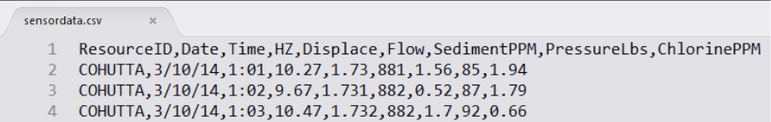
Message Data to Sensor Object
case class Sensor(resid: String, date: String, time: String,
hz: Double, disp: Double, flo: Double, sedPPM: Double,
psi: Double, chlPPM: Double)
def parseSensor(str: String): Sensor = {
val p = str.split(",")
Sensor(p(0), p(1), p(2), p(3).toDouble, p(4).toDouble, p(5).toDouble,
p(6).toDouble, p(7).toDouble, p(8).toDouble)
}
Notes:
The oil pump sensor data comes in as strings of comma separated values. We use a Scala case class to define the Sensor schema corresponding to the sensor data, and a parseSensor function to parse the comma separated values into the sensor case class.

Slide 36
DataFrame and SQL Operations
// for Each RDD
sensorDStream.foreachRDD { rdd =>
val sqlContext = SQLContext.getOrCreate(rdd.sparkContext)
rdd.toDF().registerTempTable("sensor")
val res = sqlContext.sql( "SELECT resid, date,
max(hz) as maxhz, min(hz) as minhz, avg(hz) as avghz,
max(disp) as maxdisp, min(disp) as mindisp, avg(disp) as avgdisp,
max(flo) as maxflo, min(flo) as minflo, avg(flo) as avgflo,
max(psi) as maxpsi, min(psi) as minpsi, avg(psi) as avgpsi
FROM sensor GROUP BY resid,date")
res.show()
}
Notes:
Next we use the DStream foreachRDD method to apply processing to each RDD in this DStream.
We register the DataFrame as a table, which allows us to use it in subsequent SQL statements.
We use an sql query to find the max, min, and average for the sensor attributes

Slide 37
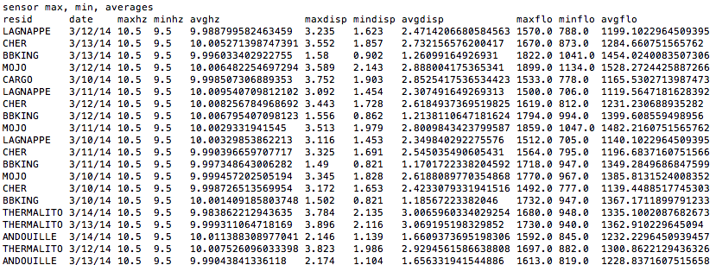
Streaming Application Output
Notes:
Here is example output from the query which shows the max, min, and average output from our sensors.

Slide 38
Save to HBase
rdd.map(Sensor.convertToPut).saveAsHadoopDataset(jobConfig)
batch time 0 to 1
batch time 1 to 2
batch time 2-3
output operation: persist data to external storage
linesRDD DStream
map
map
map
sensorRDD DStream
save
save
save
Put objects written
to HBase
Notes:
The sensorRDD objects are converted to Put objects, and then written to HBase, using the saveAsHadoopDataset method. This outputs the RDD to any Hadoop-supported storage system using a Hadoop Configuration object for that storage system.

Slide 39
Start Receiving Data
sensorDStream.foreachRDD { rdd =>
. . .
}
// Start the computation
ssc.start()
// Wait for the computation to terminate
ssc.awaitTermination()
Notes:
To start receiving data, we must explicitly call start() on the StreamingContext, then call awaitTermination to wait for the streaming computation to finish.

Slide 40








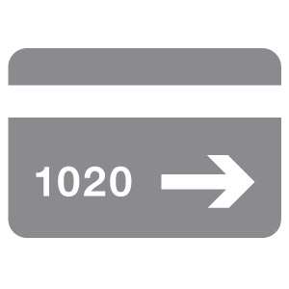

Building a Complete Data Architecture
Sources/Apps
Bulk Processing
Stream Processing
MapR File System (MapR-FS)
MapR Streams
MapR Database (MapR-DB)
MapR Converged Data Platform
Notes:
All of the components of the use case architecture we just discussed can run on the same cluster with the MapR Converged Data Platform..

Slide 41
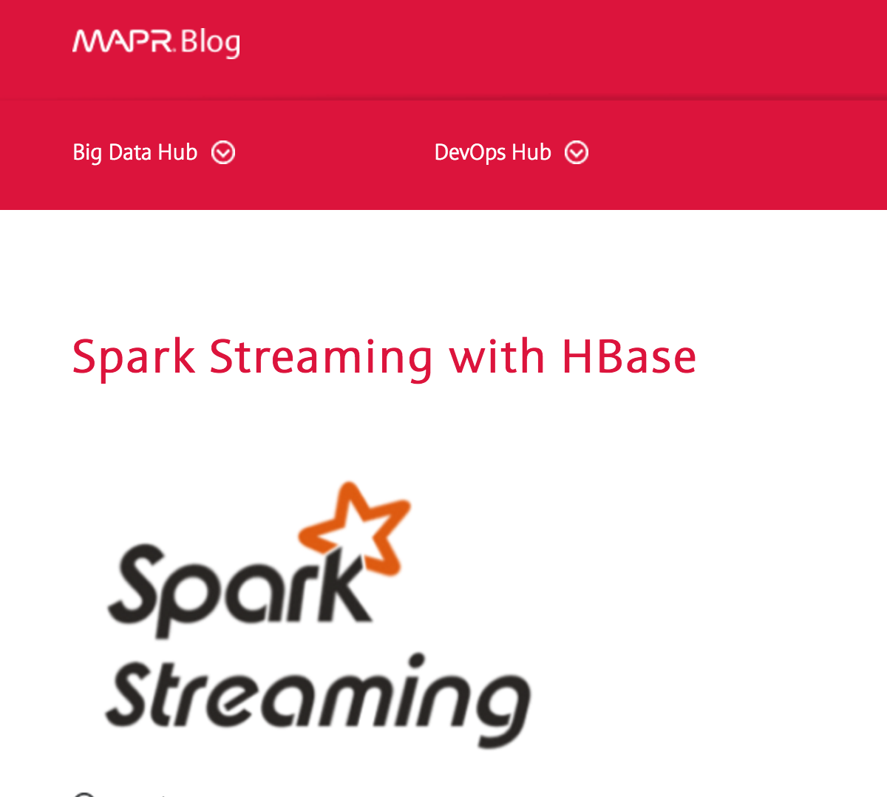
To Learn More:
Read explanation of and Download code
https://www.mapr.com/blog/fast-scalable-streaming-applications-mapr-streams-spark-streaming-and-mapr-db
https://www.mapr.com/blog/spark-streaming-hbase
Notes:
You can read an explanation of the example code and find a download like for the code in these 2 blogs.

Slide 42
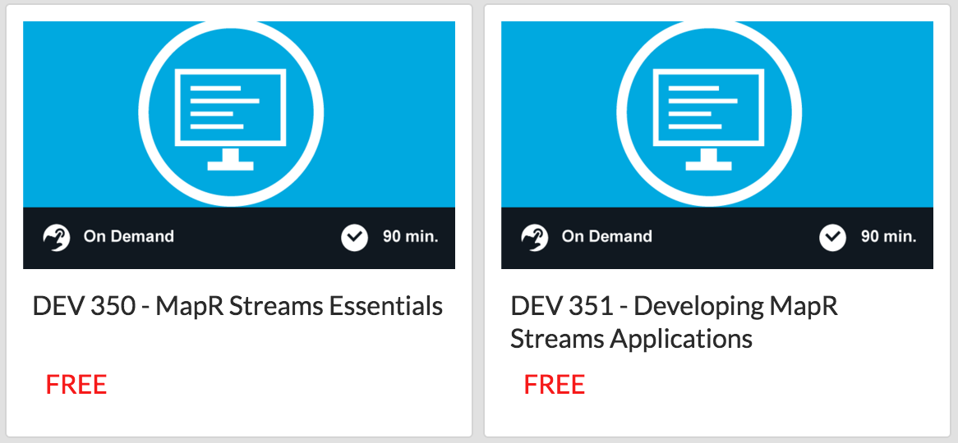

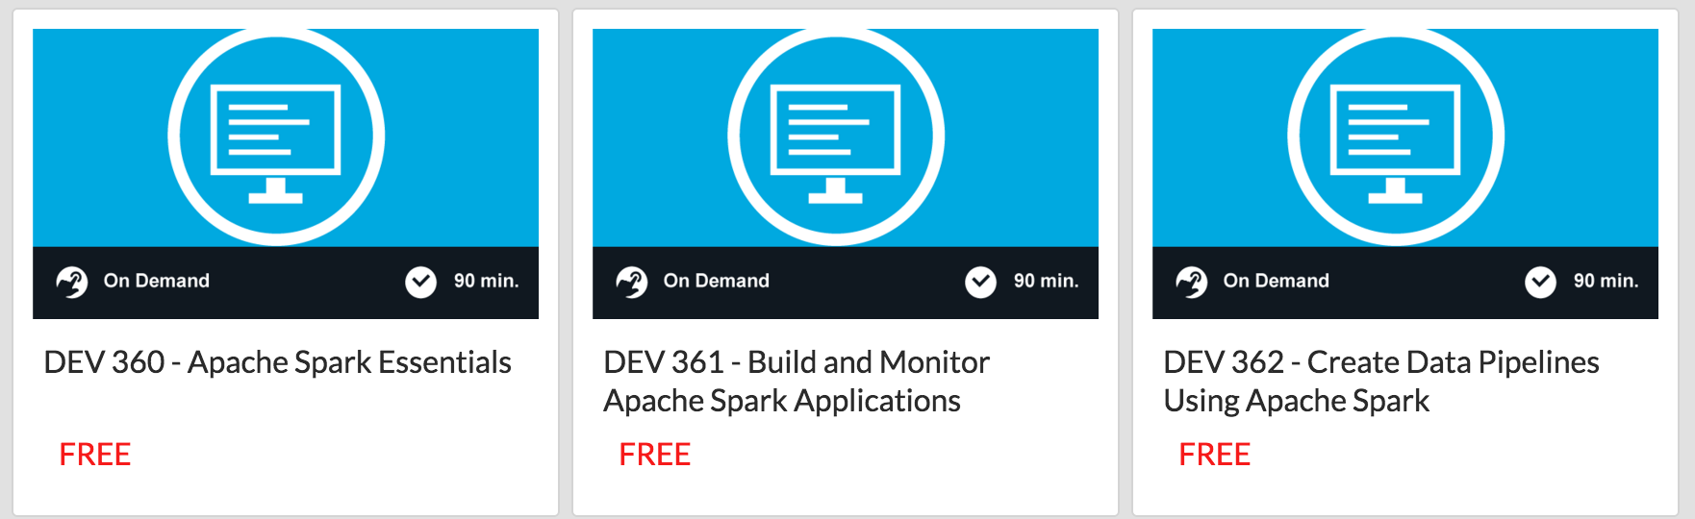
To Learn More:
http://learn.mapr.com/
Notes:
There is free on demand training , spark , hbase , mapr streams and more at learn.mapr.com

Slide 43


Q & A
Engage with us!
@mapr
@caroljmcdonald
mapr-technologies
https://www.mapr.com/blog/author/carol-mcdonald

